Slide 1
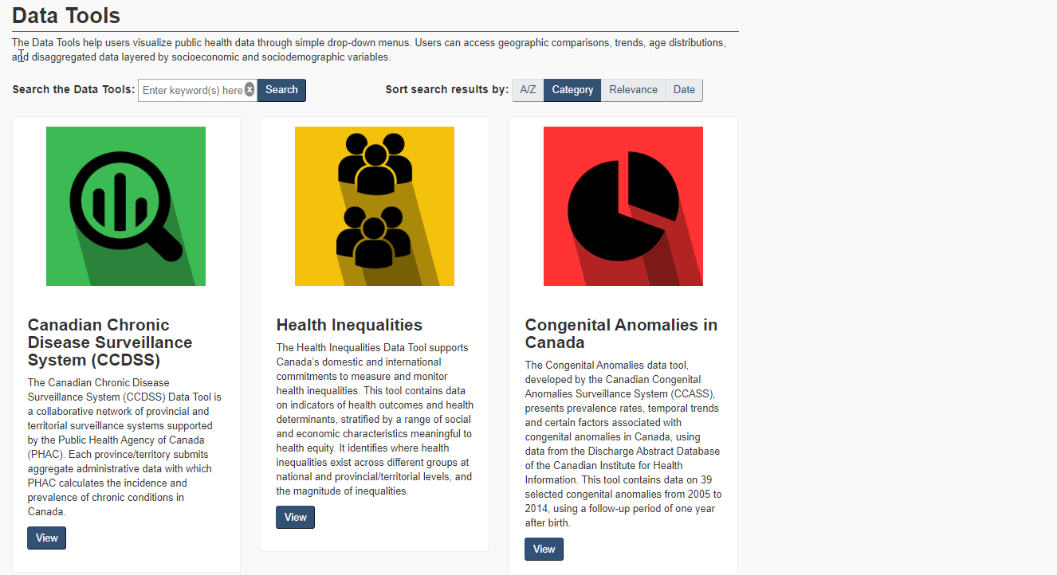

Nutrition Surveillance
The Nutrition Surveillance Data Tool was developed by the Bureau of Food Surveillance and Science Integration (BFSSI) at Health Canada. This tool presents data on usual intakes of energy, nutrients and other dietary components using data from the Canadian Community Health Survey – Nutrition focus. It highlights where Canadians’ intakes fall relative to Dietary Reference Intakes established by the Institute of Medicine of The National Academies of Science, Engineering and Medicine.

Slide 2
Nutrition Surveillance Suite of Data Tools
The Nutrition Surveillance Data Tools were developed by the Bureau of Food Surveillance and Science Integration (BFSSI) at Health Canada. These tools present data on the foods, nutrients and other dietary components that Canadians are consuming. Where possible, intakes are compared to established reference values in order to visualize

Slide 3


Nutrition Surveillance Data Tools
Usual Nutrient Intake Surveillance Tool
The Usual Nutrient Intake Surveillance Tool presents data on usual intakes of energy, nutrients and other dietary components using data from the Canadian Community Health Survey – Nutrition focus. It highlights where Canadians’ intakes fall relative to Dietary Reference Intakes established by the Institute of Medicine of The National Academies of Science, Engineering and Medicine.
Food Intake Surveillance Tool
The Food Intake Surveillance Tool presents data on the amounts and types of foods and beverages consumed by Canadians using data from the Canadian Community Health Survey – Nutrition focus.
Nutrition Status Surveillance Tool
CHMS BIOMARKER DATA?
Infant Nutrition Surveillance Tool

Slide 4
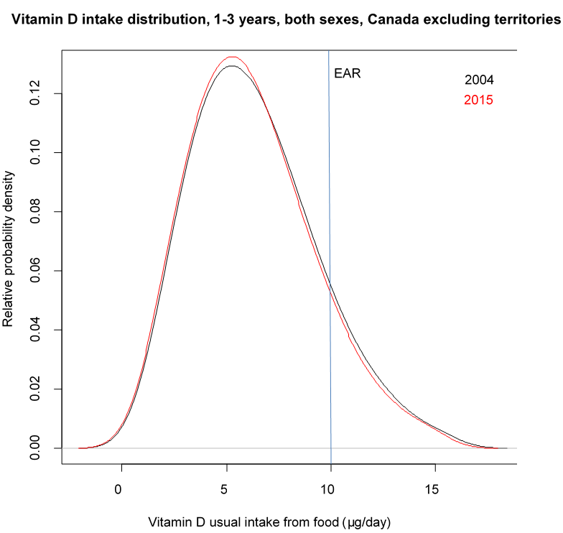
Distribution visualization requirements
Selections
Drop down menu:
Sex
Age group
Nutrient
Check boxes:
Dietary Reference Intakes
Year
UL
Data to include:
Region = Canada, excluding territories
Nutrients = See excel spreadsheet
65

Slide 5
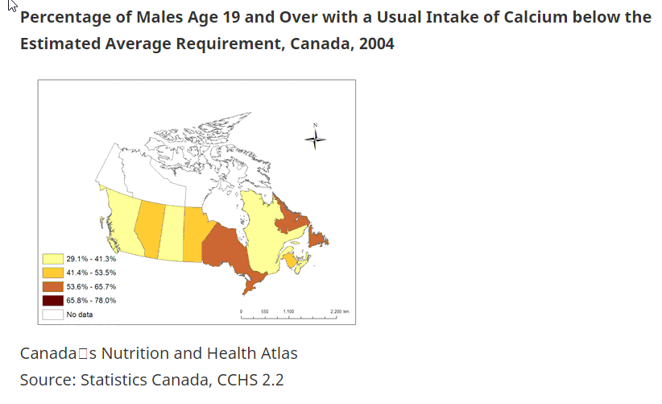
NOTE:
Combining ages together to create estimate for 19+ more challenging with NCI method. Do we feel there is sufficient need for this type of visualization?

